Slide 1
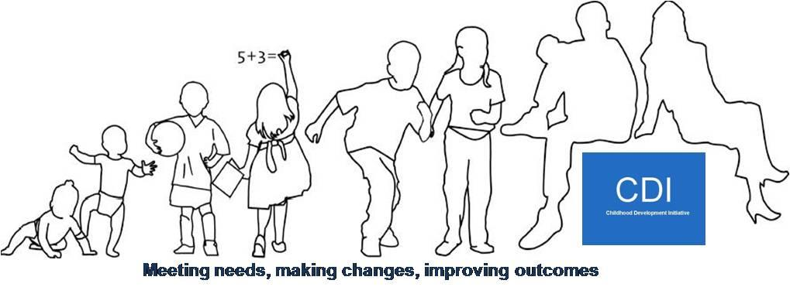
Restorative Practices In Action: A Practical Approach for Conflict Resolution in Organisations
LGMA Annual Equality Officer Seminar
2nd October 2013

Slide 2
About CDI
2007: Prevention and Early Intervention Programme, funded by DYCA and The Atlantic Philanthropies;
Tasked to design, deliver and evaluate services to improve outcomes for children and families in Tallaght West and inform policy and practice;
Seven independent evaluations published;
2013: Area Based Response to Child Poverty: integrate proven models into mainstream services.

Slide 3
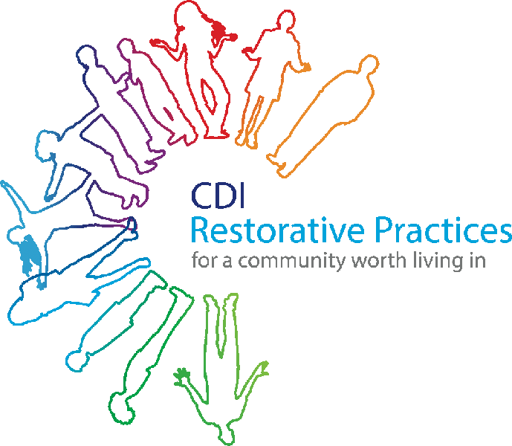
What is Restorative Practice?
Restorative Practices are about working WITH people rather than doing things TO or FOR them
RP is about offering high levels of support, whilst challenging inappropriate behaviour and encouraging acceptance of responsibility

Slide 4
CDI’s RP Programme Objectives
To create a Restorative Community in Tallaght West
The delivery of training in RP to key stakeholders with responsibility for children and young people
Accreditation of local trainers, and support to organisations and people seeking to work restoratively

Slide 5
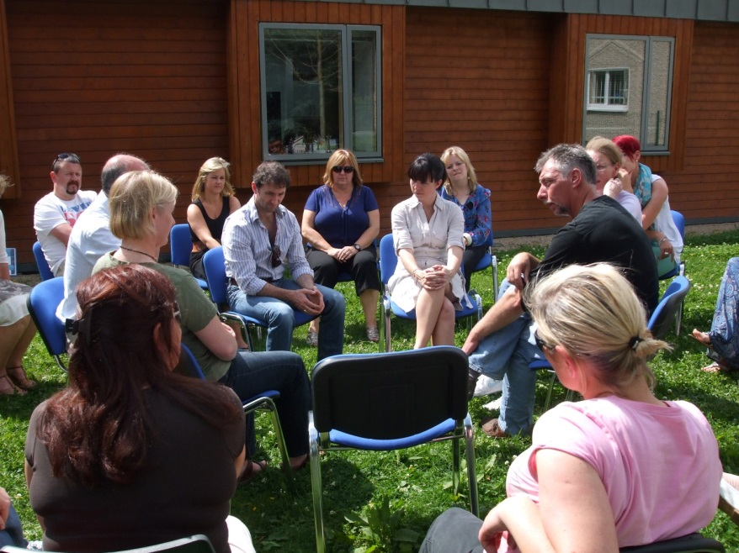
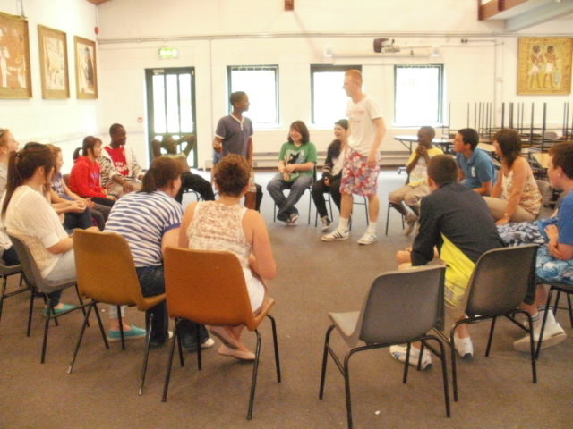

Slide 6
RP Programme Aims
Improved interagency collaboration amongst frontline staff;
Improved relationships between service providers and residents;
Increase in use of a common approach across sectors and disciplines;
Increased confidence of frontline staff in dealing with conflict situations;
Improved staff morale within participating organisations;
Increased satisfactory resolution of neighbourhood disputes in the Community Safety Initiative (CSI) Pilot Sites;
Increased reporting of anti-social behaviour and crime in the CSI Pilot Sites;
Increased confidence amongst participating parents in managing their children’s behaviour and being solution focused; and
Improved capacity amongst participating children and young people for dealing with conflict and managing problems.

Slide 7
What Did The RP Programme Do?
RP training began in 2010 (as part of our CSI);
Training provided monthly;
Trainees drawn from all agencies working with children and young people as well as residents and young people themselves;
To date (September 2013), just over 1,000 people trained, including 109 young people;
16 local trainers accredited;
St. Marks Community School became the 1st RP organisation in Tallaght in October 2012;
5 more RP organisations by December 2013;
All Ireland Restorative Practice Strategic Forum established.

Slide 8
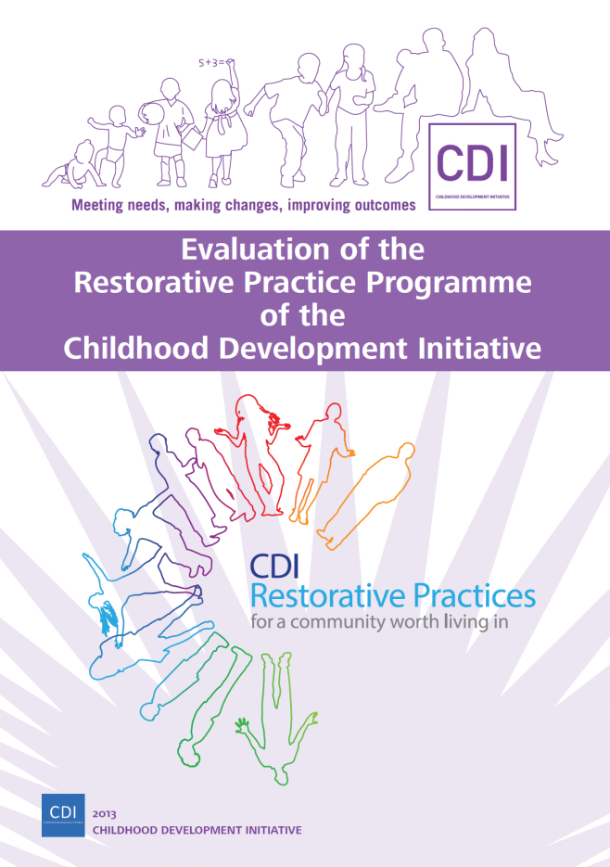
Evaluation 2010-2012:
By the Child and Family Research Centre,
National University of Ireland, Galway.

Slide 9
Main Impact Outcomes
Frequent use of Restorative Practice
75% have experienced others using Restorative Practice in work, school and community
87% better management of conflict
55% work;
46% School;
41% community.

Slide 10
Main Impact Outcomes
43% reduction in disputes with greatest gains made in the workplace
Significant improvement in people’s ability to manage conflict with greatest gains made in interagency work and between neighbours
Significant improvement in relationships with greatest gains between organisations and their service users

Slide 11
Restorative Practices Continuum
Informal Formal
Affective
questions
Small impromptu
conference
Group
or circle
Formal
conference
Affirmative language & affective
statements

Slide 12
RP Processes
Use of affective (feeling) statements and questions;
Use of circles - to build relationships, educationally, to solve conflict;
Use of impromptu (informal) conferences;
Formal conferences for serious breaches of behaviour / serious conflicts.

Slide 13
RP Can….
Build trust, understanding and mutual respect;
Encourage empathy;
Promote a sense of responsibility and ownership;
Help to focus on solutions and ways to repair harm- move from the past to the future;
Pre-empt conflicts and difficulties.

Slide 14
RP is not……
Abolishing or reducing consequences and responsibility;
Rocket science!!!

Slide 15
Affirmative Language
Drop the “why” and the “but”!!!

Slide 16
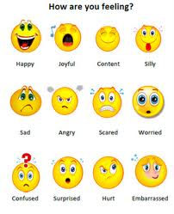
Affective Statements
This means trying to express ourselves using emotions/feelings.
Examples:
I am delighted that ….
I am disappointed that …
I am upset because…
I am very happy to see that you are ….

Slide 17
Compare the reactions that
the following statements may inspire?
How dare you arrive late again. It’s absolutely ridiculous.
V’s
I’m disappointed that you are late again. I feel frustrated that the group has been disturbed.
That looks good.
V’s
I’m thrilled with that.
Be quiet I said. Listen or you’ll be in big trouble. Do you hear me?
V’s
I feel frustrated that you are still talking. How many times have I asked you to be quiet? How many times do you think is reasonable yourself? What can we do next to help/fix this situation?........ Well I’d feel very happy if we could make that work.
Who do you think you are talking to?
V’s
I’m upset that you have spoken to me that way.
Well done on the project.
V’s
I’m delighted to see you being so creative.

Slide 18
The Why of Affective Statements
Develops emotional literacy skills – identify, express and share how we/others feel.
Develops empathy - people can understand the impact of their behaviour.
They may then be more likely to choose to change negative behaviour.
Working “with” - instead of “to”, “for” or “not”
Ability to separate the deed from the doer- promotes less reactive/defensive responses.

Slide 19
Think. Pair. Share.
1. Think of examples of situations in your daily life (work or home) that may benefit from the use of affective statements.
2. Consider how you/others may normally react.
3. Compare this to the use of an affective statement (if different).
4. Share your examples and the impact you’d expect the affective statement to have (pair work).

Slide 20
Any Questions?
www.twcdi.ie
http://twitter.com/twcdi
Canoeing Circle 2012
http://www.facebook.com/ChildhoodDevelopmentInitiative

