Slide 1
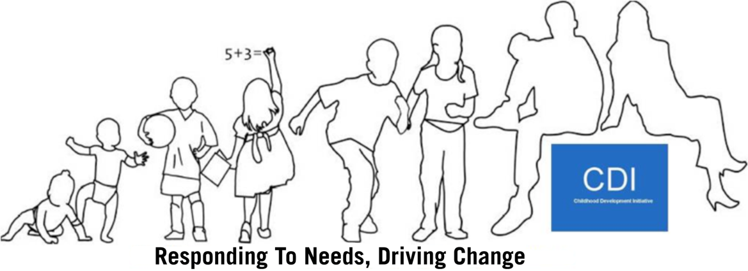
Restorative Practices in Tallaght West
Waterford Restorative Practices Network Launch
20th May 2015

Slide 2
Programme Objectives
To create a Restorative Community in Tallaght West
The delivery of training in RP to key stakeholders with responsibility for children and young people
Training of local trainers and support to organisations and people seeking to work restoratively

Slide 3
Intended Outcomes
Improved interagency collaboration amongst frontline staff;
Improved relationships between service providers and residents;
Increase in use of a common approach across sectors and disciplines;
Increased confidence of frontline staff in dealing with conflict situations;
Improved staff morale within participating organisations;
Increased satisfactory resolution of neighbourhood disputes in the Community Safety Initiative (CSI) Pilot Sites;
Increased reporting of anti-social behaviour and crime in the CSI Pilot Sites;
Increased confidence amongst participating parents in managing their children’s behaviour and being solution focused; and
Improved capacity amongst participating children and young people for dealing with conflict and managing problems.

Slide 4
Elements of CDI’s RP Programme
RP training began in 2010 (as part of our CSI);
Training provided monthly;
Trainees drawn from all agencies working with children and young people as well as residents and young people themselves;
To date (May 2015), over 1,300 people trained;
St. Marks Community School became the 1st RP organisation in Tallaght in October 2012, SDCC Social Work Team in 2013, 5 primary schools in 2014, plans for all youth services 2015;
All-Ireland Restorative Practice Strategic Forum established 2011.

Slide 5
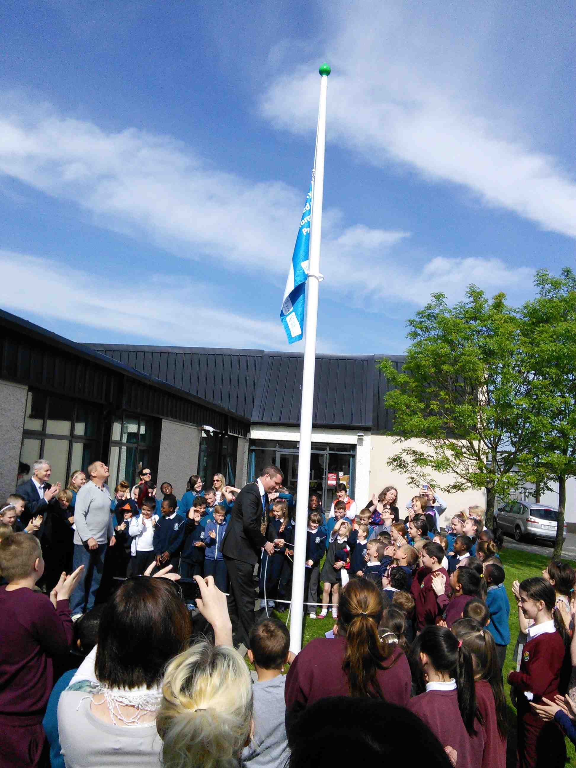
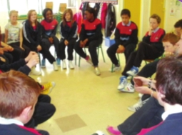
SCP Afterschool 2011
Foróige Youth Club 2012
Primary School Launch 2014

Slide 6
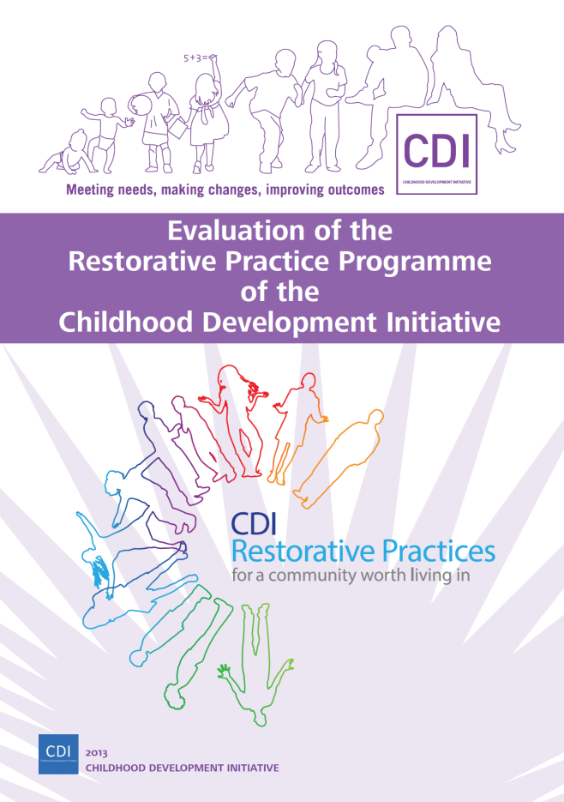
Evaluation 2010-2012
By the Child and Family Research Centre,
National University of Ireland, Galway.

Slide 7
Main Impact Outcomes
Frequent use of Restorative Practice
75% have experienced others using Restorative Practice in work, school and community
87% better management of conflict
55% work;
46% School;
41% community.

Slide 8
Main Impact Outcomes
43% reduction in disputes with greatest gains made in the workplace
Significant improvement in people’s ability to manage conflict with greatest gains made in interagency work and between neighbours
Significant improvement in relationships with greatest gains between organisations and their service users

Slide 9
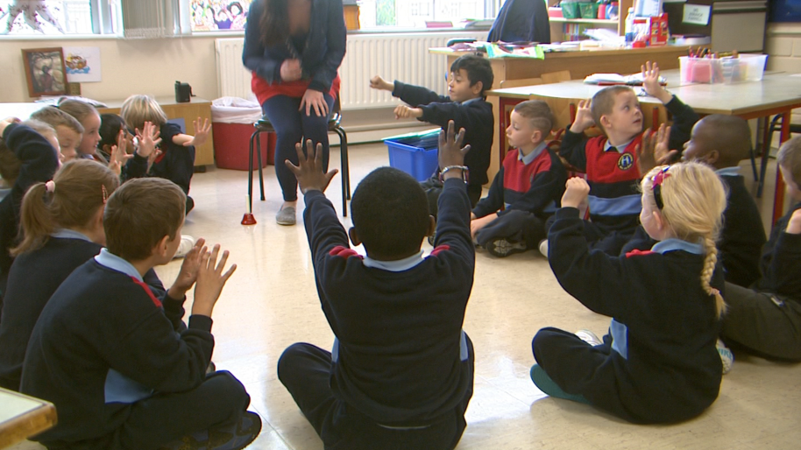
Current Status
Developing sustainable mechanisms for the ongoing implementation of RP.
Dissemination of learning to relevant stakeholders nationwide.
RPSF working on promoting RP, developing standards, quality assurance.
St Marks Junior School, 2013

Slide 10
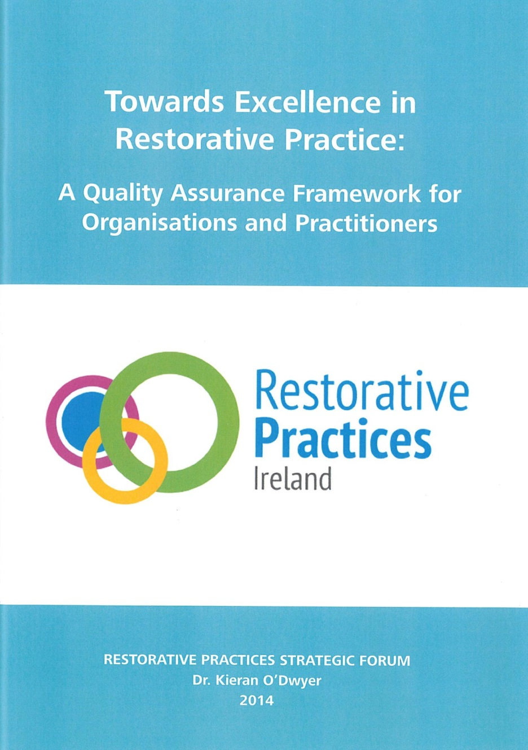
www.restorativepraticesireland.ie

Slide 11
Any Questions?
www.twcdi.ie
http://twitter.com/twcdi
Canoeing Club Circle 2012
http://www.facebook.com/ChildhoodDevelopmentInitiative

