Slide 1
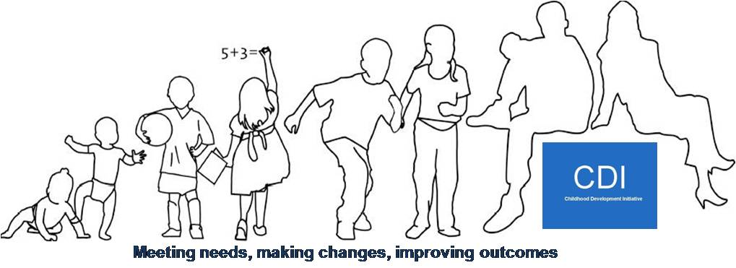


The truth, the whole truth and nothing but the truth:
Rigorous evaluations in community settings.

Slide 2
Overview
  CDI to date;
  CDI: a complex community initiative;
  The evaluation profile;
  Key challenges, principles and processes to enable effective evaluation in communities;
  Sharing the learning.

Slide 3

CDI to Date
  Seven services designed, delivered and evaluated;
  Seven evaluation reports and nine policy papers published;
  Final process evaluation published next month;
  Further reports being completed;
  Doodle Den Longitudinal Study and SLT follow-up underway.

Slide 4
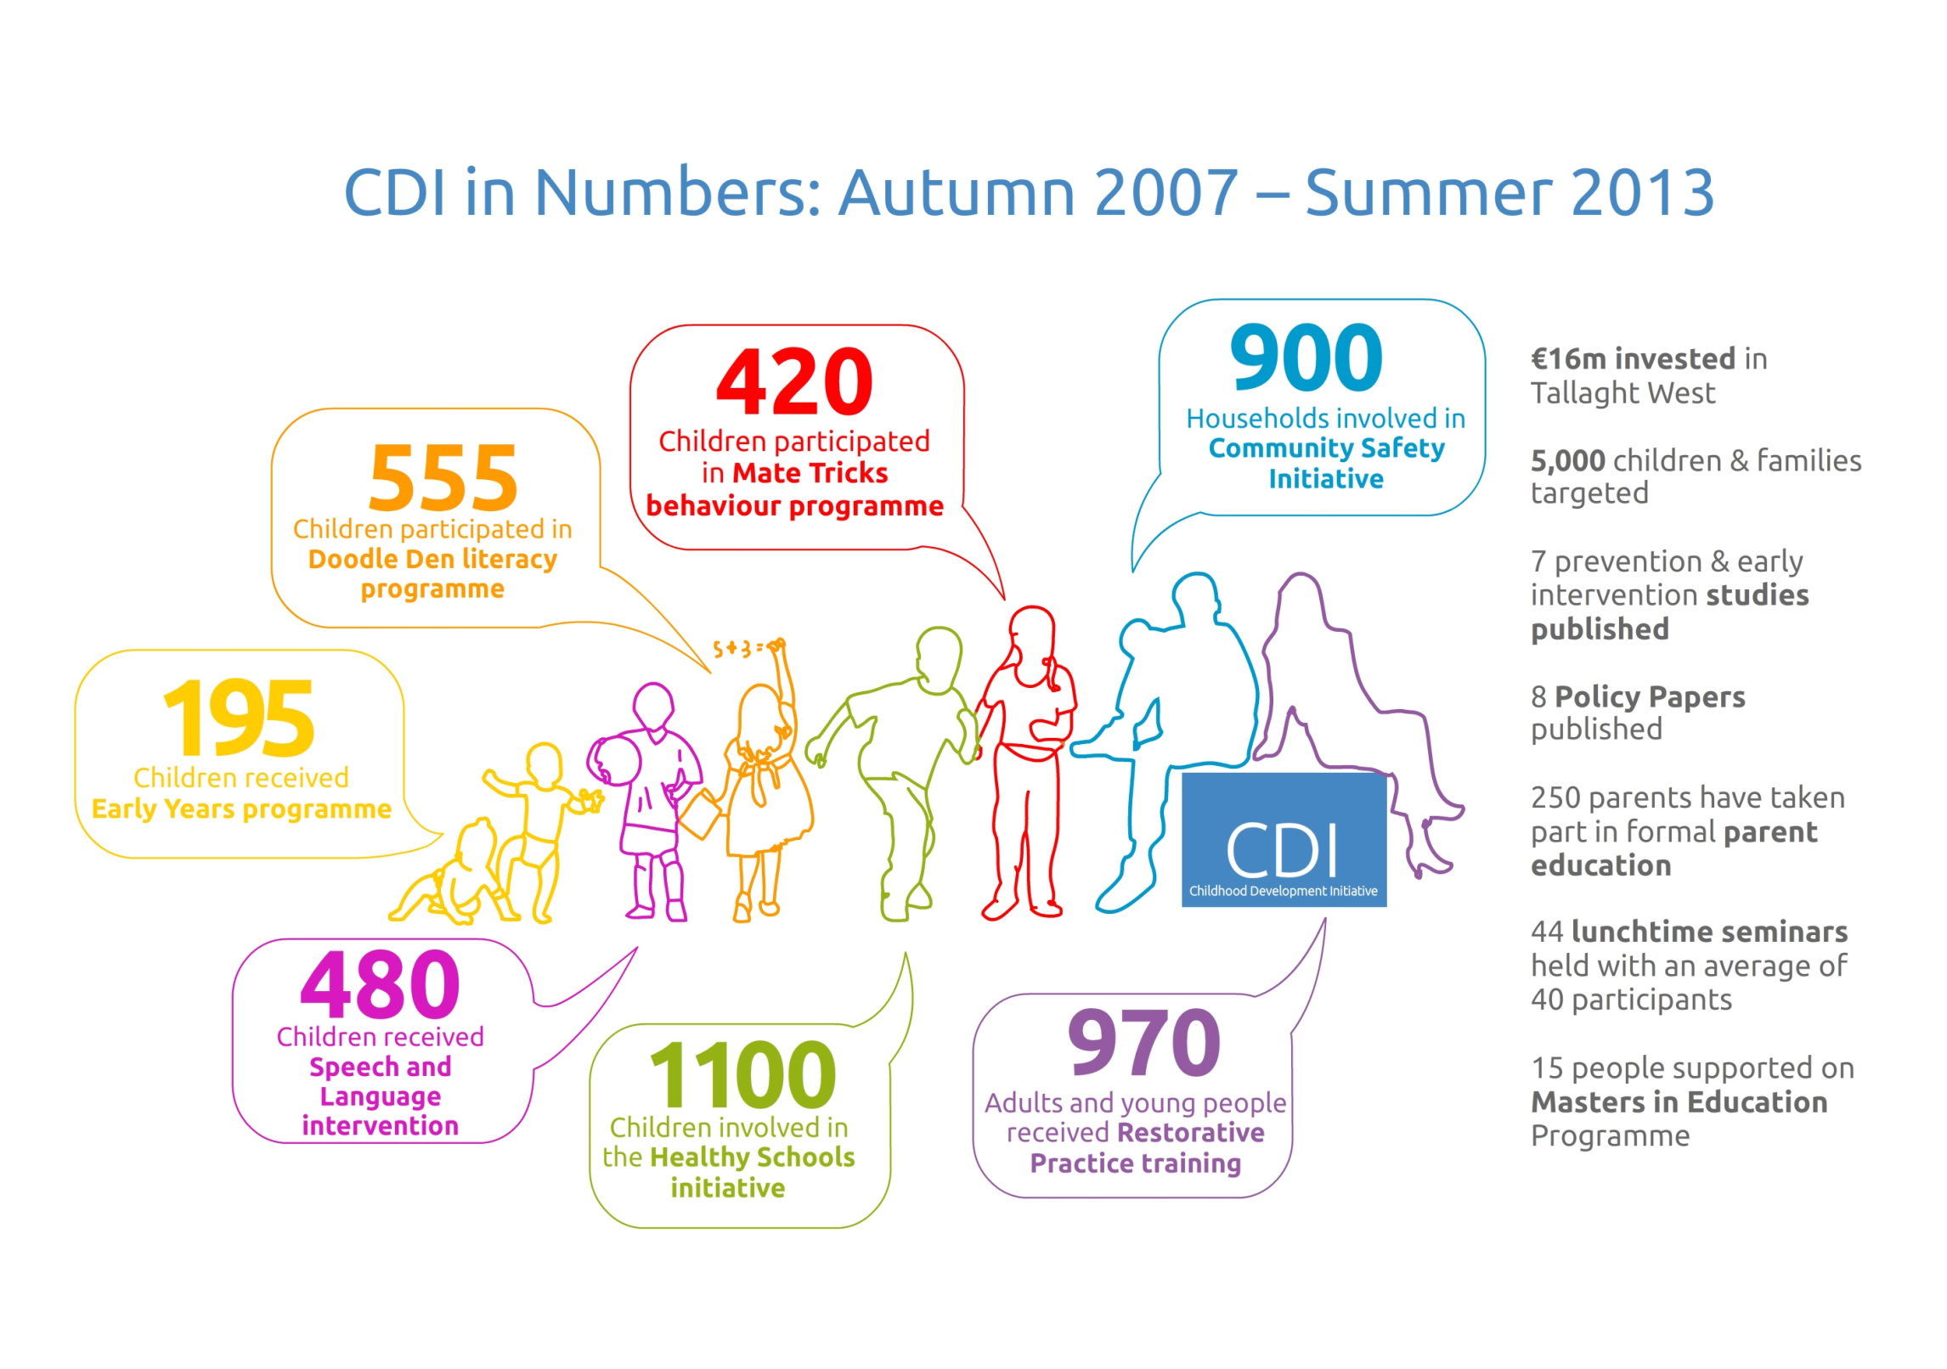

Slide 5
Area Based Childhood Initiative:
New funding initiative from DCYA and AP;
Focus on sustainability of programmes, and their integration into existing structures and mainstream services;
Centralised evaluation being undertaken by CES;
Opportunity to respond to unmet needs based on evaluations and local consultation.

Slide 6
Core Activities 2013-2016:
Parent support in early years;
Early intervention speech and language service;
Doodle Den and development of Doodle Den booster;
Restorative Practice Strategic Development;
0-3 initiative;
Sharing the learning and dissemination.

Slide 7
What is a Complex Community Initiative?
Comprehensive, attempting to address many issues at once;
Involve a high degree of coordination, collaboration and integration, often between and within different sectors, at local, regional and national level;
Operate in an outcomes-focussed manner, which increases accountability for actions;
Responsive to local needs and flexible in meeting those needs;
Focused on building capacity;
Prevention and early intervention-focused;
Family and community focused;
Participatory; and
Universal in focus, ( NUIG, pending) .

Slide 8
CDI Evaluations:
3 Randomised Controlled Trials
ECCE – (DIT)
Doodle Den – (QUB)
Mate Tricks – (QUB)
Community Safety Initiative – (NUIG)
Restorative Practice – (NUIG)
Overall Process Evaluation – (NUIG)
3 Process Evaluations
Quasi-Experimental Study
Healthy School’s Programme – (TCD)
Retrospective Impact Study
Speech & Language Therapy

Slide 9
Challenges:
Getting buy in from a range of stakeholders;
Time lapse between funding allocation and delivery : ‘collective amnesia’;
What do we expect of community representatives? Is it comparable to our expectations of ‘experts’?
Managing negative findings when people are invested in the work;
Understanding capacity across the various disciplines.

Slide 10
Research related challenges:
Coordinating multiple evaluations – e.g. timing of fieldwork in schools; families involved in multiple programmes; sufficient resources to review and approve documents;
TW is a research ‘haven’;
Are we a producer or consumer of evidence?
Are we a community based organisation or a research unit?
Is our priority quality research or meeting needs?
Engaging policy makers in the absence of evaluation findings.

Slide 11
Principles:
Honesty:
    hands up when we get it wrong;
    Acknowledge when we don’t know;
Integrity:
    Being comfortable with expecting some things not to work – don’t take it as personal failing but rather as a great learning opportunity !
Equity:
    We don’t expect more of our community partners than our ‘experts’;
    Find ways of giving all stakeholders a voice;
Fun:
    Because its always good to laugh!

Slide 12
Effective processes:
Developing an open, respectful relationship with the evaluation team through formal and informal mechanisms;
Learning across disciplines – sharing the best of what we have;
Focus on strengths but don’t be afraid to name deficits;
Organisation: regular meetings, concise minutes; clear actions;
Reflection groups: local engagement in signing off reports.

Slide 13
De-commissioning services:
Even with hard evidence, its difficult to get people to let go;
This is an emotional process – expect tears!
Map your stakeholders;
Sequence your engagement with them;
This is a partnership between the evaluation team and the commissioner;
Be gentle!

Slide 14
Sharing the learning:
Seven reports published;
Nine policy papers published
Process evaluation and policy paper due to be launched next month;
Plans to develop policy paper on stopping what doesn’t work;
REPP book.

Slide 15

Final words of wisdom….
There’s more than one way to skin a cat!

Slide 16



Contact us
www.facebook.com/childhooddevelopmentinitiative
http://twitter.com/twcdi
www.twcdi.ie
info@twcdi.ie

