Slide 1
Service Evaluation Processes and Liabilities:
A Commissioner’s Perspective.
Irish Evaluation Network, 6th November 2015.

Slide 2
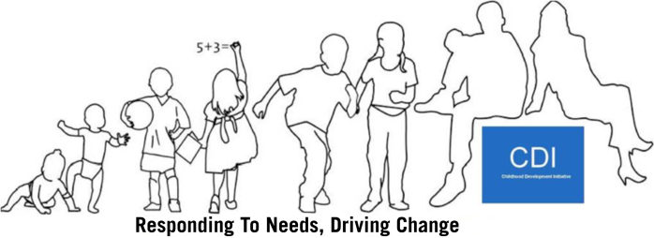
Overview
Introduction to CDI;
CDI’s Commissioned Research to date;
The Commissioning Process;
Reviewing interim and final reports;
Dissemination Processes;
Liabilities;
Questions?

Slide 3
Introduction to CDI
2004-2007:
Community activity and concern re: outcomes for children;
Local audits, needs assessments, service gaps;
Atlantic Philanthropies strategic move to include non-third level investment;
Government recognition of need for dedicated focus on children.

Slide 4
Agreement that
Something needs to change!

Slide 5
CDI: Initial Phase
2007-2012:
Establishment of an organisation, governance structures, staffing etc.;
Service design based on agreed priorities;
Commissioning of 30 service providers and 8 evaluation teams;
Delivery of services to 5,000 children and families in Tallaght West;
Completion of eight independent evaluations;
Commencement of dissemination process.

Slide 6
CDI Research
3 Randomised Controlled Trials
ECCE – (DIT)
Doodle Den – (QUB)
Mate Tricks – (QUB)
Community Safety Initiative – (NUIG)
Restorative Practice – (NUIG)
Overall Process Evaluation – (NUIG)
3 Process Evaluations
Quasi-Experimental Study
Healthy School’s Programme – (TCD)
Retrospective Impact Study
Speech & Language Therapy

Slide 7
Subsequent and Ongoing Independent Research
SLT:
Comparison Study of CDI and HSE Services
Family Literacy:
Literative Review;
Pilot Process Evaluation:
Quasi-Experimental Study.
Longitudinal Study of Doodle Den
Ante-Natal to Three Initiative:
Baseline audit re: interagency links;
Evaluation of service outcomes.
Family Links Prison Programme:
UL iterative evaluation.
Community Safety:
Evaluation of RAPID role and mainstreaming.

Slide 8
The Commissioning Process
Procurement Requirements for Publicly funded research:
Depending on value of the contract:
Three verbal quotes;
Three written quotes;
Closed competitive tender;
Open competitive tender;
www.tenders.ie;
www.tenders.eu.

Slide 9
What we do in CDI
Identify the need for research/evaluation;
Consider the key research questions, based on our logic model;
Consider appropriate methodology;
Identify and ring-fence appropriate budget;
Draft a Request for Tender document for Board approval;
Commence procurement of researcher(s).

Slide 10
To date:
We have commissioned research to the value of approximately €2m;
We have national and international expertise to support our work;
Our level of exposure to, and experience in, research and evaluation, is unique in the Community and Voluntary sector.

Slide 11
Questions to be considered when drafting an RFT
How clear is the intervention?
Have SMART outcomes been identified? (logic model)
How clear and appropriate are the research questions?
How fixed or flexible is the methodology?
What level of organisational readiness is there for this process?
Who owns the research?

Slide 12
Reviewing an RFT Submission
Score sheets;
Explicit relevant experience;
Well written and succinct;
Realistic timelines and costs;
Openness to working things through with us.

Slide 13
Review Processes:
Scheduled progress meetings to trouble shoot and maintain momentum;
Regular dialogue to promote collaboration;
Agreed milestones, targets and timelines.

Slide 14
Liabilities:
Contractual clarity re: IPR;
Evaluation team participation in reflection group process;
Management of contentious issues (weighting of views);
Quality re: qualitative vs quantitative;
Quality of writing/proof reading;
Managing negative findings.

Slide 15
Challenges:
Coordinating multiple evaluations – e.g. timing of fieldwork in schools; families involved in multiple programmes; sufficient resources to review and approve document;
TW is a research “haven”;
Are we a producer or consumer of evidence?
Are we a community based organisation or a research unit?
Is our priority quality research or meeting needs?
Engaging policy makers in the absence of evaluation findings.

Slide 16
De-commissioning services:
Even with hard evidence, its difficult to get people to let go;
This is an emotional process – expect tears!
Map your stakeholders;
Sequence your engagement with them;
This is a partnership between the evaluation team and the commissioner;
Be gentle!

Slide 17
Dissemination
CDI owns the research data, so leads this process.
However, researchers are encouraged to publish.
Methods Include:
Reflection meetings;
Published reports;
Policy papers;
Conference presentations;
Family and children focused events;
Media – print and radio;
Oireachtas Committee presentations;
One-to-one meetings and presentations at key policy making structures.

Slide 18
Any Questions?

