Slide 1


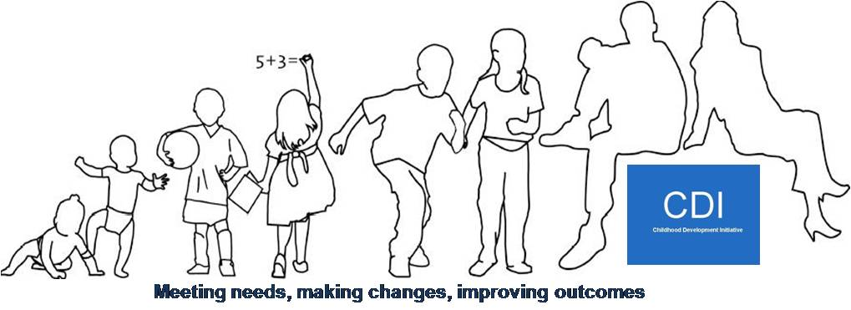


Evaluation of the Speech and Language Therapy Service of Tallaght West Childhood Development Initiative
Grainne Smith - Quality Specialist, CDI
Michelle Quinn –A/Senior SLT, SDCCC/CDI/HSE
Siobhan Keegan – Lead Researcher, CSER, DIT

Slide 2
Introduction to the Childhood Development Initiative
Gráinne Smith
Quality Specialist, CDI.

Slide 3
Background and Overview of the Childhood Development Initiative:
Consortium of 23 people
Needs assessment, audit of services;
Ten year strategy developed.
Funders:
- The Atlantic Philanthropies;
-The Office of the Minister for Children and Youth Affairs;
-Five years.
One of three PEIP sites
10 year strategy to improve the outcomes of children and families in Tallaght West

Slide 4
Aims:
To develop new services to support children and families
Encourage better integration of education, social care and health provision
Promote community change initiatives

Slide 5





CDI Services:
Early Year’s Programme (2 year early intervention programme – Dedicated PCF and SLT).
Doodle Den Literacy (Senior Infants – facilitated by teacher and youth worker).
Mate-Tricks Pro-Social Behaviour Programme (4th Class - facilitated by teacher and youth worker).
Healthy Schools Programme (Whole school).
Community Safety Initiative

Slide 6
Prevalence of S&L Need:
1 in 10 children (2 or 3 in every classroom) have communication difficulties that require specialist help (UK statistics).
Up to 55% of children in disadvantaged areas experience speech and language difficulties at age five years (Locke et al, 2002).

Slide 7
Early Year’s Programme:
Two-year Early Year’s programme that combined the following elements:
Non-contact time;
1:5 staff:child ratio;
Communities of Practice (CoP).
HighScope curriculum for 4 hours 15 minutes per day, five days a week, academic year.
Access to a dedicated Speech and Language Therapist
A dedicated Parent/Carer Facilitator – parenting course
9 preschools in Tallaght West

Slide 8
Healthy Schools Programme:
A whole-school approach to promote integrated health promotion and to improve access to and uptake of health care services/professionals:
Work programme focusing on activities to achieve seven outcomes outlined in a manual.
Implemented in five primary schools located in two campuses:
Two Healthy Schools Coordinators (HSC) employed.
Inter-agency Steering Committee established (Principals and reps from HSE, SDCC, HSCL, CDI):
In 2008 CDI agreed to provide a SLT service on site, on a part time basis initially, and after one year, the post became full time.

Slide 9
Governance Structures/Process:
Involvement of HSE crucial;
Employment – community based organisation;
Memorandum of Understanding (MoU);
Supervision structures – clinical/non-clinical;
Dual policy;
Service level agreement.

Slide 10
Evaluation Process:
Importance of evaluation – create an evidence base to inform policy and practice;
Retrospective evaluation;
Tendering process:
  Funding – different thresholds;
  Being clear about what you want to evaluate;
  Breath versus depth;
  Good relationship with research team.

Slide 11
Overview of Speech and Language Therapy Service
Michelle Quinn
A/Senior Speech and Language Therapist, CDI/HSE/SDCC.

Slide 12

SLT Programme Objectives:
To promote children’s speech and language development and provide intervention, where necessary
To provide training and support to parents
To provide training to staff in early years settings and primary schools

Slide 13
Three Pronged Approach:
Child
Parents
Staff
Notes:
The three pronged approach essentially developed out of the programme objectives. This means providing a service to all of these key stakeholders, whether it be through direct or indirect intervention or via parent information sessions or through staff training.
With a focus on onsite service delivery in schools and preschools, Essentially moving away from the historical Medical model and moving more towards a social model of intervention.

Slide 14



SLT Service Structure:
2 full time SLT’s
Employer
Funder
Clinical Supervision
Notes:
Employer: HR, Leave, Administration of salaries and monthly progress meetings
Funder: Fund the programme, organises evaluation of the programme
Clinical supervision and Programme support: Principal SLT Dublin South West, Rosemary Curry
Supervision is provided to the staff grade SLT by the Senior SLT.
We participate in team meetings with the DSW team

Slide 15
Service Provision:
3/5 primary schools involved in the Healthy Schools Programme:
  Junior national schools only
Scope of the service:
  Junior Infants only
Clients range in age from 4-6
Visit each school 1 day per week
8 preschools
1 Early Start
Scope:
  Anyone attending the preschool
Clients range in age from 2 years 6 months to 4 years 6 months
Healthy Schools
ECCE Sites
Notes:
Clients are eligible for the ECCE service for the duration that they are attending the preschool.
Clients are eligible for the healthy schools service for their Junior Infant year.

Slide 16
Model of Service Delivery:
Intervention takes place within the school;
Direct Therapy:
  1:1; group
Indirect Therapy:
  Home/preschool/school programme
  Parent/staff training
Emphasis on parent and staff involvement;
Regular review and reassessment as needed.
Notes:
Parents/carers are encouraged to be as involved as possible in their child’s therapy to aid carry over from therapy to the home e.g. they are required to attend appointments, given home programmes etc.
Parents/carers involvement in the SLT service will be supported by the SLT and ECCE staff as needed e.g. arranging suitable appointment times, offering opportunities to discuss concerns etc.

Slide 17
Collaboration:
‘Best Practice’;
RCSLT Clinical Guidelines- School age children with speech and language difficulties should receive intervention within the school system;
Collaboration between therapists and early year’s staff/teachers is key to appropriate and effective intervention.

Slide 18
Education and Prevention:
The education strand of the SLT service will be of benefit to all children, not just those referred.
The aim is to:
(1) Prevent communication difficulties by providing environments and interactions that support communication development
(2) Identify at an early stage children who are presenting with communication difficulties or who are at risk of communication difficulties
(3) Minimise the impact of communication difficulties for those children who present with them

Slide 19
Education and Prevention:
Parent/Carers
Childcare workers & Managers
Managers & School Principals
Parent Carer Facilitators/ Healthy Schools Co-ordinator
Notes:
So if we look at the child at the center, these are all the major key stakeholders in the child's life.
This was the focus of our education and prevention.

Slide 20

Education and Training with Staff:
All staff (Principals; Teachers; SNA’s; Resource Teachers; ECCE Staff) have been offered training modules by the SLT. These training modules have included:
Identifying children with communication difficulties
Typical speech, language and communication development in the preschool and school aged child
Supporting language development in classroom
Supporting literacy development in classroom
Supporting children for whom English is an additional language

Slide 21
Education and Prevention for Parents:
Reading to your Child
Typical development
Giving up Soothers and Bottles
Encouraging language development at home
Speech carnival- community Initiative
Coffee Mornings
Notes:
Generally this is carried out in a more informal way, mainly during coffee mornings in the preschool/ school.
Again moving away from the medical model, to a more social model of intervention and access.
And also remembering the context that this is a DEIS area, high levels of unemployment, low levels of literacy, its always important for us to remember who our audience are.

Slide 22

Referral: how can people refer?
CDI SLT Service
Only open to children currently enrolled in dedicated preschools involved with the ECCE and Healthy schools programme
Referrals are accepted from individuals involved with the child’s care e.g. Parents, teachers and teaching staff, Public Health Nurses, Family Support Workers etc.
Referrals must have consent form attached signed by the parent or a carer with the power to consent on behalf of the parent
Children who have been referred to, or are currently attending, HSE Dublin South West community SLT service are managed in line with the dual service policy.

Slide 23
Dual Service Policy:
All referrals to CDI SLT service are crosschecked with the HSE. Parental consent is obtained for this;
Children waiting for HSE Community SLT are generally transferred to CDI SLT service;
Children attending national specialist services may be jointly managed by the specialist service and the CDI SLT service e.g. Cochlear Implant, Cleft Palate, National Rehab Hospital;
Children attending specialist SLT services are not appropriate for CDI SLT service, as we are a uni-disciplinary SLT service;
Children on waiting lists for specialist SLT services are eligible for CDI SLT service up to the point that they commence with the specialist agency;
Notes:
1)To see if they are known to the HSE community service.
2)As we generally have no waiting lists, children referred to us will usually be assessed within a month and will go straight into therapy if required.

Slide 24
Discharge Policy:
Children may be discharged for one of the following reasons:
  Communication development assessed as being within normal limits;
  Transition from the Preschool sites;
  Transfer to specialist services;
  Parental request following discussion with SLT;
  Child does not meet criteria for service provision;
  Termination of SLT programme.
Co-operative working with parental consent regarding transfer of management will occur for all transfer cases.

Slide 25
Research Findings
Siobhan Keegan
Lead Researcher, CSER, DIT.

Slide 26

Evaluation Methodology:
Retrospective evaluation (2010-2011);
Two strands:
  Quantitative - looking at referral numbers, accessibility, uptake, and outcomes;
  Qualitative – looking at implementation, from parents, staff and CDI’s perspective.
Added layer: comparing CDI SLT service with local SLT services.

Slide 27

Referrals:
Cohorts | Number Referred | Number Accepted | Number Not Accepted N/A | Reason for N/A | No. CDI SLTs
Cohort 1 | N=54 (27 Boys; 27 Girls) | N=39 (72.2%) | N=15 | 12 – Within Normal Limits (WNL); 3 – Receiving SLT from another service. | 1
Cohort 2 | N=138 (93 Boys; 45 Girls) | N=118 (85.5%) | N=20 | 16 – WNL; 2 – Receiving SLT from another service; 2 – Unknown. | 2
Total | 192 i.e. 42% of total cohort* | 157 (81.7%) | 35 (18.3%)

Slide 28
Caseload Comparison:
Figures for the period Autumn 2010 to Summer 2011
 | CDI | SLT 3* | SLT 4* | SLT 5* | SLT 6*
Number of SLTs | 2 (1:36) | 1.5 (1:131) | .5 (1:198) | 2.7 (1:103) | 1.8 (1:59)
Referrals received | 72 | 197 | 99 | 279 | 106
Referrals accepted | 72 | 195 | 95 | 275 | -
Children in direct therapy | 59 | 38 | 30 | 154 | 81
Average age | 2yrs 9 months | 7 yrs 9 months | 7 yrs 4 months | 6yrs 5 months | 7 yrs 3 months
Waiting time | 2-4 wks – 6 months | 15-18 months | 15-18 months | 15-18 months | 15-18 months
* HSE Services

Slide 29
Waiting Times for CDI/Agency Services:

Slide 30
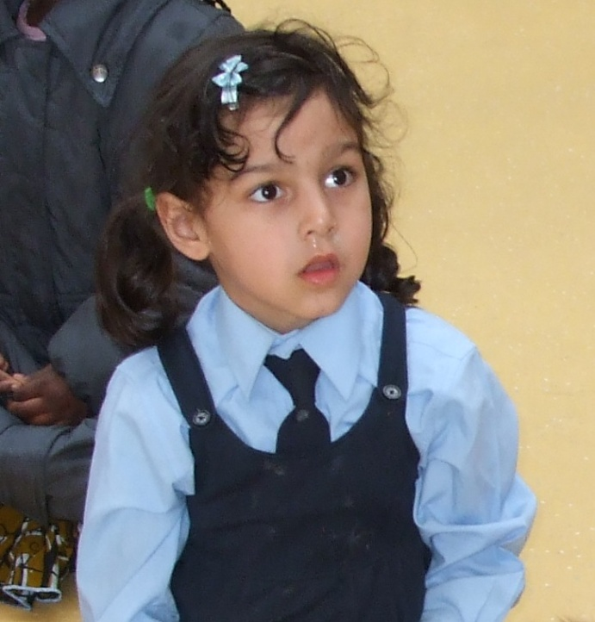
Responding to Need:
Up to 55% of children in disadvantaged areas experience speech and language difficulties at age five years (Locke et al, 2002).
Not Previously Referred to the HSE
106/157 (55-66%)

Slide 31
Case Management:
Proportion: | Referred To:
18% | Discharged within normal limits following therapy
51% | HSE
31% | Still in CDI

Slide 32
Factors Related to Outcomes:
Significantly more boys than girls required ongoing speech and language therapy:
  28 per cent of girls discharged within normal limits;
  12 per cent of boys discharged within normal limits.
Of those who resolved within normal limits, none had multiple needs;
Of those who resolved within normal limits, a minority (n=3) had a severe need.
Notes:
The sex of children was an important factor with regard to outcomes. Significantly more boys than girls required ongoing speech and language therapy.

Slide 33
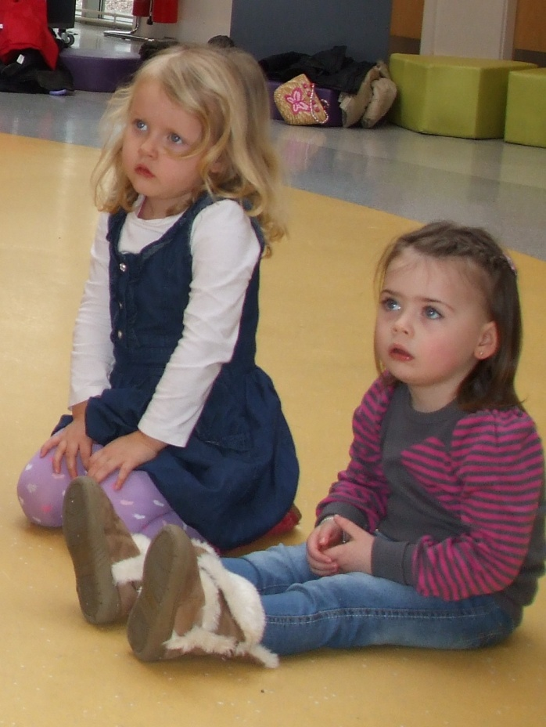
Child Attendance @75-100% of Appointments:
Early Years | Healthy Schools
82% | 85.3%

Slide 34
Parent Attendance @75-100% of Appointments:
Early Years | Healthy Schools
50% | 64.7%

Slide 35
Parent Attendance: Initial Assessment:
Attendance at initial assessment was reported to be close to 100% at the CDI;
HSE states that attendance at initial assessment was closer to 50%.

Slide 36
Parents’ Views:
SLT
Better understanding of speech and language
Bringing the service to the child
Children more ready for school - developmentally and socially
More confidence in responding to their child’s difficulties
“Ripple effect” – parents can apply learning to other children in their family
Supported children’s development

Slide 37
Parent Quotes:
“I think we realised his talking was different …[we were] so afraid … that he’d be bullied.”
“Everyone can understand her now … she won’t get slagged now”.
Notes:
Quotes on beneficial outcomes

Slide 38
Staff and other Agencies’ Views:
Staff (Early Years and Schools):
Deeper understanding of speech and language development and concerns;
Changes in practice as a result of speech and language training;
More access to support and advice.
Other SLT Agencies:
Transfer of children to/from agency and CDI - Positive impact; good relationships;
High level of support from HSE – role support to the CDI SLTs, resulting in greater connection of services.

Slide 39
Practicalities of Research into Speech and Language Therapy:
Different instruments used by different therapists/for different needs;
Professional judgement used - hard to quantify;
Statistical programmes and common reporting systems have a lot to offer for the management and treatment of speech and language needs;
SLTs as researchers;
Room for more cross discipline collaboration on research into speech and language.

Slide 40
CSER, DIT – Key Recommendations:
Further investigation required to determine the long-term impact of intervention;
Raise the profile of SL service, both targeted and at population level, to educate parents about its benefits and importance of early intervention and to understand the referral system;
Further research on transition from the CDI service to HSE – inform HSE planning and strategy development to maximise attendance and engagement;
The training opportunities central to this model should be available to all staff who work in the education of young children.

Slide 41
Policy
Relevant Outcomes

Slide 42

Policy-Relevant Outcomes:
Early SL Intervention Provision:
  Strong potential for Early Year’s services and schools to identify, and intervene, in the case of children with speech and language needs and to support their families through the therapy process;
  At least 18% of children transitioned from the service with normal speech and language post-intervention. This finding is particularly positive in the context of Tallaght West, which has an over-representation of families at risk of experiencing multiple disadvantages (CDI, 2004 and 2005);
  The intervention effectively removed one further risk factor from the lives of a proportion of these children.
Notes:
Intervene not in the sense of therapy but in raising it with the parents as a concern etc.

Slide 43
Policy-Relevant Outcomes:
Promotion of Access to Health Services:
  39 children referred to other non-SLT specialist services.
Improved Knowledge and Responsiveness to SL issues:
  For Early Years practitioners and teachers to respond to speech and language issues. This led to changes in practice related to the support of speech and language development within the Early Years services and schools.

Slide 44
Policy-Relevant Outcomes:
Improved Therapists’ Wellbeing:
  Therapists fulfilled by working in an intensive manner with children. Made possible by short waiting lists and on-site therapy over the course of the school/Early Years service term;
  HSE counterparts reported frustration at having to deal with long waiting lists and block therapy delivery;
  Strong support for on-site targeted SLT provision, particularly in terms of therapists’ well-being, job satisfaction and productivity.
Improved Parental Accessibility and Engagement:
  Parents reported easier access because of the model’s pre-school location;
  Found experience non-stigmatising for their child and convenient;
  Highlights the need for other SLT and specialist services to give consideration to location and accessibility issues.

Slide 45
References:
For the full report on the evaluation findings please see:
Hayes, N., Keegan, S. and Goulding, E. (2012) Evaluation of the Speech and Language Therapy Service of Tallaght West Childhood Development Initiative. Dublin: Childhood Development Initiative (CDI).
For more details on the Early Intervention
Speech and Language Service please visit
http://twcdi.ie/early-years-service/

Slide 46
References:
Bishop, D. and Adams, C. (1990) ‘A prospective study of the relationship between specific language impairment, phonological disorders and reading retardation’, Journal of Child Psychology and Psychiatry, Vol. 31, No. 7, pp. 1027-50.
Law, J., Lindsay, G., Peacey, N., Gascoigne, M., Soloff, N., Radford, J. and Band, S. (2002) ‘Consultation as a model for providing speech and language therapy in schools: A panacea or one step too far?’ Child Language Teaching and Therapy, Vol. 18, No. 2, pp. 145-63.

Slide 47
Thank you……….!
To all the previous SLT’s who have been involved in the programme;
To Rosemary Curry, Principal Speech and Language Therapist, DSW;
To the HSE DSW Speech and Language therapy team.

Slide 48
Thank you for Listening,
any Questions?
Hayes, N., Keegan, S. and Goulding, E. (2012) Evaluation of the Speech and Language Therapy Service of Tallaght West Childhood Development Initiative. Dublin: Childhood Development Initiative (CDI).
http://twcdi.ie/early-years-service/
Notes:
And finally thank you for listening. Grainne, Siobhan and I are happy to answer any questions you may have.

