Slide 1
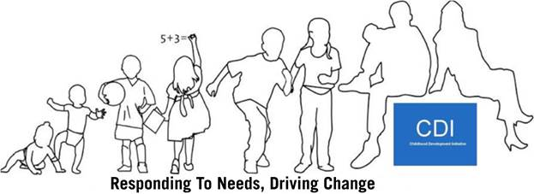
Family Links:
Supporting Parenting for Prisoners and their Partners
Pat Dawson, Governor,
Limerick Prison,
and
Marian Quinn, CEO, Childhood Development Initiative

Slide 2
Irish Penal Reform Trust:

Slide 3
Key Recommendations from IPRT Report:
A family strategy to be drawn up by the IPS;
Number of children with a parent in prison should be recorded;
A consultative group with children and families to be established in each prison;
Temporary release for the purposes of maintaining the family relationship;
Children’s Officers and Family Links Officers should be established in every prison;
Family-friendly visits should be available, and visitors should feel safe during their visit;
Criteria should be explicitly set out as to how to qualify for special family visits, based on the best interests of the child;
A properly staffed phone booking system is required;
A protocol should be introduced for the use of sniffer dogs;

Slide 4
Key Recommendations from IPRT Report:
Flexibility in terms of visiting hours for children and families;
Training and monitoring of all prison officers who are in direct contact with children and families;
Standardised complaints procedure for visitors;
Audio or video recordings of a book which allow children to hear their parents;
An evaluation of the current Skype pilot programme in Limerick Prison;
Facilitate the father-child relationship by creating a child-friendly atmosphere;
Integrated Sentencing Management (ISM) Community Integration Plan (CIP);
Families should be facilitated in participating in this process if they desire.

Slide 5
Families and Imprisonment Group:
Three Year Strategic Plan 2012 – 2015:
“Strengthen family supports to facilitate on-going contact with prisoners while in custody and their reintegration post release, with appropriate supports and programmes.”

Slide 6
Initial Steps:
Prison surveys
Consultation
Liason with other groups
Visit to other jurisdictions

Slide 7
Visits: The opportunity
Rehabilitation
Positive intervention
To enhance resettlement
To reduce recidivism
17,725 Visitors in 2014 including 5,015 children

Slide 8
Shaping our policy:
Human Rights
UNCRC & ECHR
Evidence-based
Children of Prisoners – EU Coping Project (2013)
Enhance resettlement and reduce reoffending
Enhance children’s well-being
Reduce inter-generational offending
Potential to enhance the smooth running of prisons
Childhood Development Initiative:
Independent evaluation of CDI’s Early Service found the parental component to be effective in improving capacity and confidence.

Slide 9
Short Term Objectives:
Personnel training is provided in relation to introduction to parenting and developmental milestones:
Communications;
Community services.
Consultation undertaken to inform the adaptation of Parents Plus for imprisoned parents and their partners;
Delivery of adapted Parents Plus;
20+ IPS staff have increased knowledge, skills and awareness re: how to support positive parenting;
Family visits are positive and meaningful to all participating;
Increased empathy and communication within the participating prisons;
Improved connections between prisons and local services;
Improved relationships between imprisoned fathers, their partners and children;
Safety levels are maintained.

Slide 10
Longer Term Objectives:
The IPS adopts family friendly policies and procedures, and integrates parental supports;
IPS staff, across disciplines, have the capacity to deliver, monitor and enhance supports for parents;
Dissemination of evaluation findings and consideration of implications for policy and practice;
Improved relationships between imprisoned parents and their families results in reduced recidivism and inter-generational offending.

Slide 12
National Strategic Group:
To lead the strategic development of supports, policies and procedures to improve relationships between parents in prison and their families;
To drive innovation, best practice and reflection;
To liaise with and support the evaluation team through the Expert Advisory Group;
To consider and progress policy issues nationally;
To disseminate the learning from Family Links;
To review implementation of Child Protection Policy.

Slide 13
Local Implementation Group (LIG):
To coordinate and trouble shoot logistics and actions in relation to the implementation of Family Links in Limerick Prison;
To ensure appropriate communication locally across stakeholder groups;
To drive the delivery of actions and timelines as set out in the Family Links business plan;
To report to the National Strategic Group on progress, issues arising and potential solutions;
To support the evaluation process.

Slide 14
Role of Family Liaison Officer:
Support prisoners with their parenting skills;
Deliver ‘formal’ parent training to a selected group of prisoners – and become accredited;
Support other staff in promoting positive parenting;
Participate in other forms of positive parenting training and awareness raising;
Support the development and implementation of a positive parenting strategy for the prison;
Participate in ongoing structured support and supervision processes;
Participate in an evaluation of this initiative.

Slide 15
Local Progress:
Limerick prison identified as initial pilot site;
Local Implementation Group (LIG) established with representation from:
Bedford Row;
Childhood Development Initiative;
Probation Service;
Psychology Department and Prison teachers;
University of Limerick;
Parents Plus.
Engagement with Tusla ongoing.

Slide 16
Limerick Prison

Slide 17
Limerick Prison

Slide 18
Limerick Prison:
Constructed 1817-1821;
Remand and Sentenced prisoners;
Committal rate in 2014 (1716 Male/1164 Female );
Daily average population 230/27;
Staff 213.

Slide 19
Local Achievements:
Training delivered to Limerick Prison staff in:
Communications;
Child protection;
Understanding/ empathising with parents experiences;
Role of family Liason Officer.
25 Prison Officers trained as FLO’s;
Nine prisoners and their partners selected based on agreed criteria for inclusion/ exclusion;
Parents Plus Programme delivered to fathers in prison, and mothers in Bedford Row;
Second group now selected.

Slide 20
Strategic Developments:
Funding received from Katharine Howard Foundation;
University of Limerick commissioned to undertake independent evaluation of Family Links;
Child Protection Policy adapted and piloted in Limerick Prison. Review underway;
Census piloted in Limerick Prison collating data on:
Educational attainment;
Personal and family offending history;
Children: ages, frequency of visits; care arrangements.
Census now being undertaken in Castlerea and Wheatfield Prisons, with intention to roll out across all prisons.

Slide 21
Census Findings:
We estimate upwards of 6,000 children may be affected by having a parent in prison;
Satisfaction with facilities and how visits managed increases with child age;
Feeling about visits more positive for prisoners with family in prison;
Plenty of scope for extracting really useful information from survey.

Slide 22
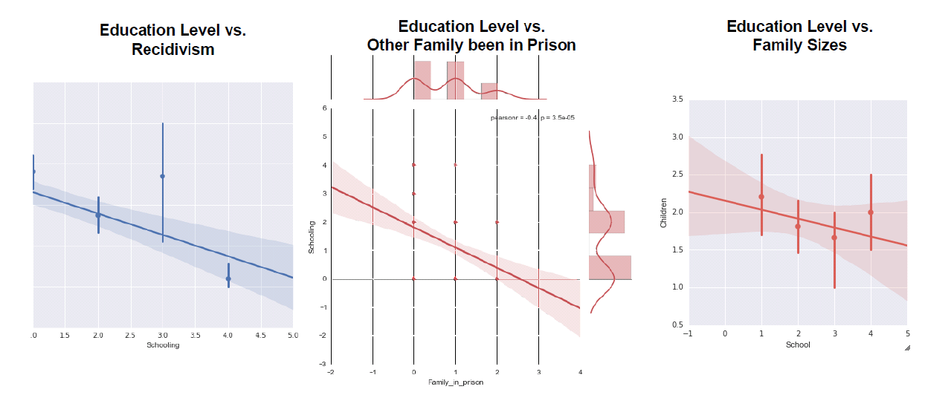
Trends – Education Levels:

Slide 23
Interim Findings:
Children always know their Dad is in prison, but they keep it a secret if that’s what mum wants;
The peer sharing and support is hugely important, especially for the mothers;
Self-care becomes a focal point for women;
There is a need for further awareness raising and training in relation to child protection;
Aspects of the formal parenting programme need to be adapted for the needs of the target group.

Slide 24
Challenges:
Finding agreement on a common vision and approach between five, disparate organisations;
Layers of communication;
Concerns re: intimidation in relation to child protection policy;
Prisoner’s family profiles can be complex so following up in the community can be time-consuming;
Helping fathers improve their parenting skills when they have limited access to their children;
Balancing a family-friendly approach alongside the need to maintain security;
Logistical issues re: inside/outside delivery;
Culture shift within prison re: role in relation to families.

Slide 25
Invisible Walls:

Slide 26
Next Steps:
Review of Child Protection Policy;
Replication in Wheatfield Prison;
Consider management of “newly assertive” women;
Establishment of family and children’s consultative group in Limerick Prison;
Development of Programme Manual and Implementation Guide;
Completion of Independent evaluation and consideration/ dissemination of findings.

