Slide 1
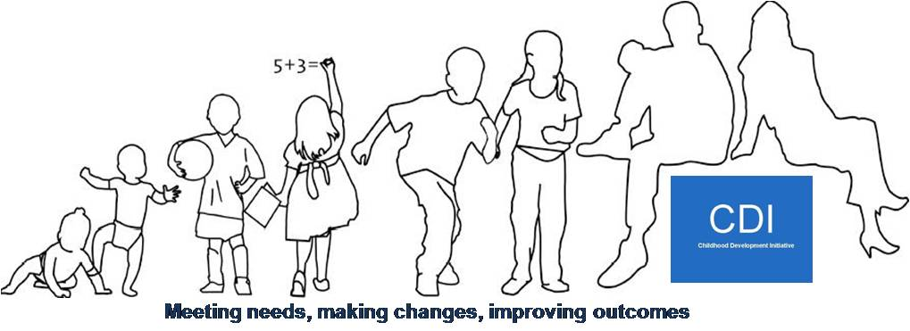


Childhood Development Initiative
DCYA Update
June 24th 2015

Slide 2
Overview
* Phase One activities and outcomes (2007-2012);
* Bridging phase (2013-2014)
* ABC activities, successes and challenges (2014-2016).

Slide 3

Phase One
  Seven services designed, delivered and evaluated;
  Eight evaluation reports and eleven policy papers published;
  Round table discussions held with senior policy influencers for each evaluation
  Advisory committee established for 3 services

Slide 4
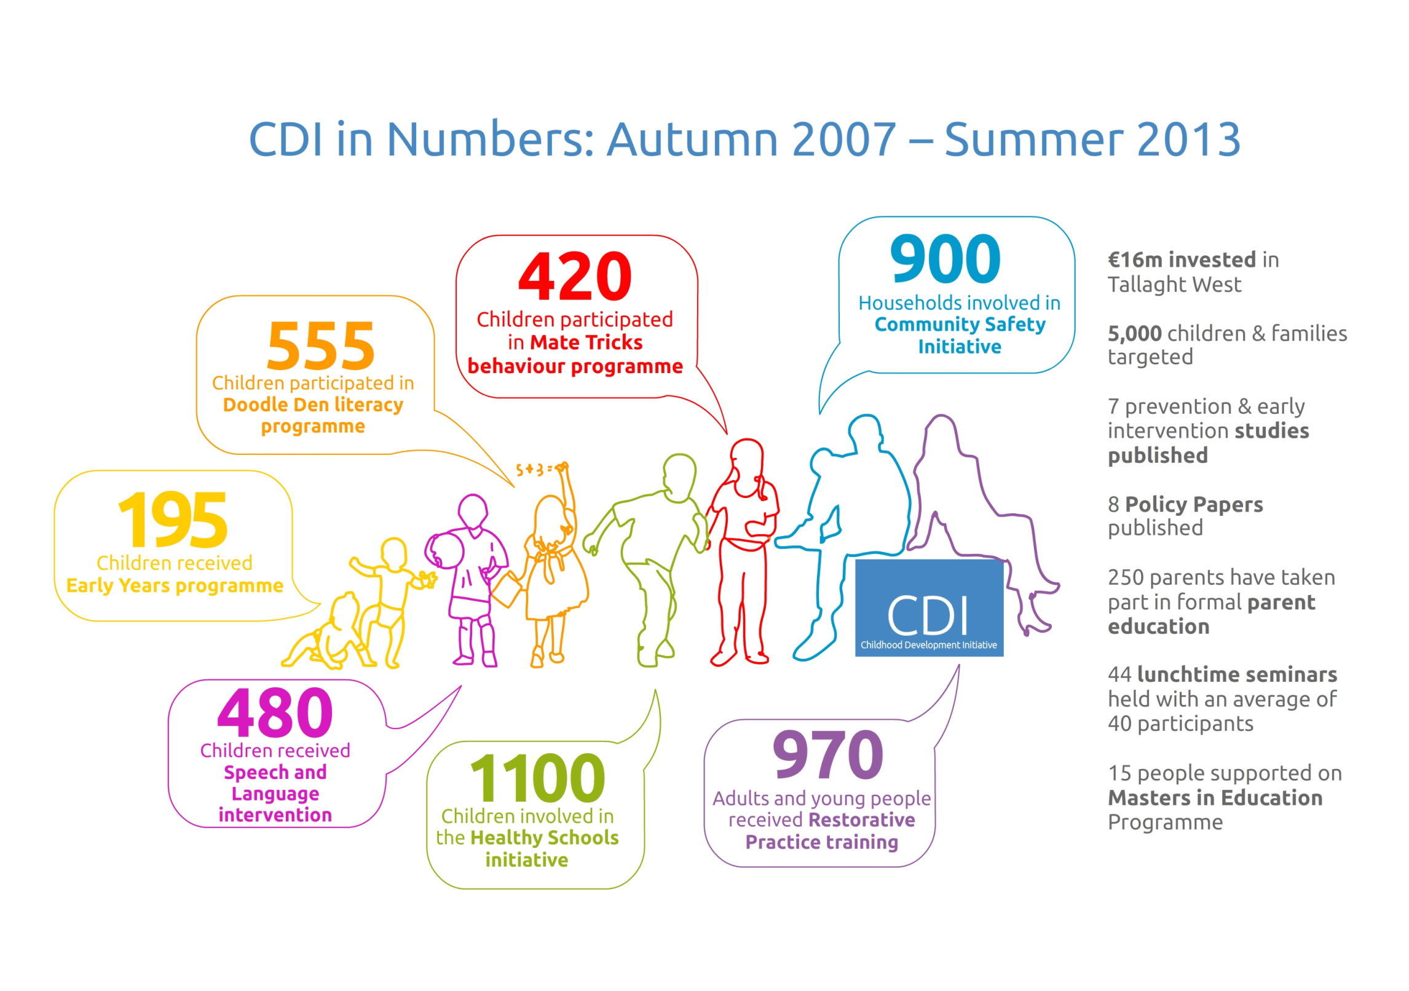

Slide 5
Bridging Phase
Maintaining services while evaluation reports finalised and conclusions interpreted;
Mate-tricks de-commissioned;
Healthy Schools and CSI reduced and ceased;
Continuation of advisory committees.

Slide 6
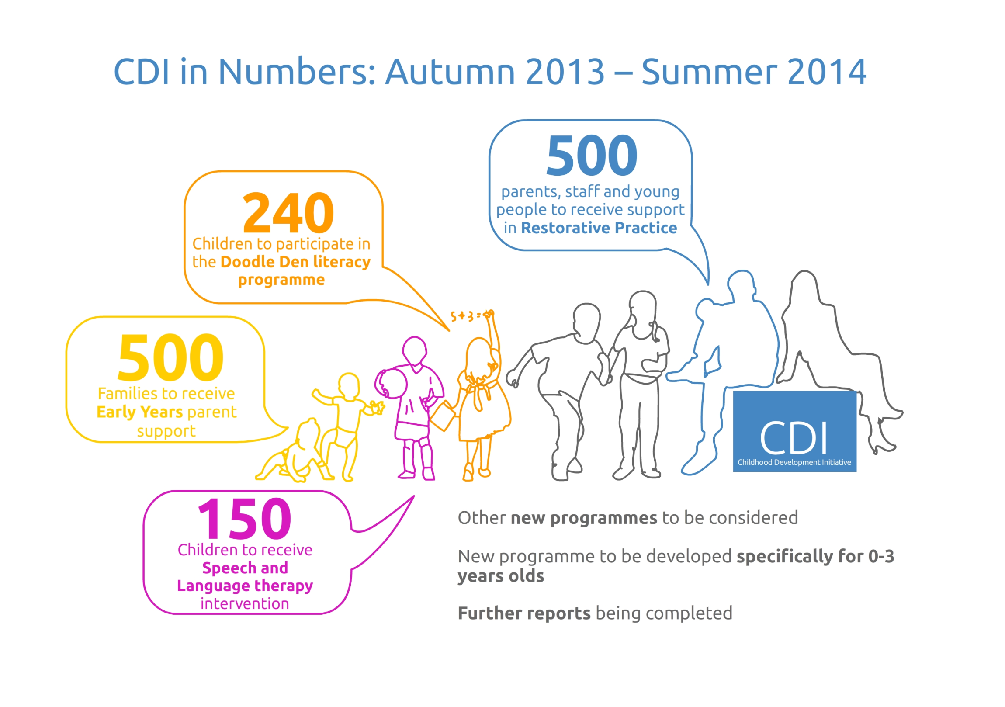

Slide 7
ABC Phase: Key Principles
Continuation and replication of proven or promising models;
No further local evaluation - monitoring to be undertaken centrally by Pobal and CES;
Focus on sustainability of programmes, and their integration into existing structures and mainstream services;
Collaboration with other sites;
Mainstreaming to be undertaken centrally.

Slide 8
Identification of Core Activities:
Primarily based on recommendations from independent evaluations;
Negotiations with DCYA and AP;
Requirement to reduce submission costs by 20% (May 2013);
Reduction in CDI staffing.

Slide 9
Core Activities 2013-2016:
Parent support in early years;
Early intervention speech and language service;
Doodle Den;
Doodle Families;
Restorative Practice Strategic Development;
Ante Natal to Three Initiative (ATTI);
Families Imprisonment Parenting Programme (KHF funded);
Sharing the learning.

Slide 10
Parent Support in Early Years
Nine PCFs supported in nine EY services;
Brief widened to engage other families from neighbouring EY services/schools/health centres;
Focus on formal and informal parenting courses and accessing external agencies;
Quality assurance and support primarily though South Dublin CCC.

Slide 11
PCF Challenges
Sustainability of service in TW;
Integration of the model into other structures and services.

Slide 12
Early Intervention Speech and Language
Two SLTs employed;
South Dublin CCC employment ceased;
Working in 10 EY services (including an Early Start) and three Primary schools;
Caseload of approx. 140 children;
Deliver parent and staff training, formal and informal;
Support SDCCC in delivering annual/bi-annual training to parents/staff in wider area.
Participating in follow-up evaluation.

Slide 13
SLT Challenges
Employment of SLTs through CCC;
Comparative evaluation of CDI and HSE SLT services highly problematic;
Offer to fund additional SLT post within HSE not progressed.

Slide 14
Doodle Den
After school literacy programme for 5-6 year olds;
Currently 20 groups running in 4 counties;
Some groups identified alternative sources of funding.

Slide 15
Doodle Den: Challenges
Review of SCP ongoing, lack of clarity re its ongoing role;
Reduced funding of SCP;
Specific funding issues in three Ballyfermot schools;
Identification of appropriate structures for delivery;
Capacity building to quality assure delivery.

Slide 16
Doodle Den Plus
Identified locally in order to sustain benefits for children;
Consultation process involved:
  Local agencies and parents
  Policy/’expert’ groups
  Literature review
Pilot completed and Mary Immaculate evaluating implementation;
For roll out autumn 2015.

Slide 17

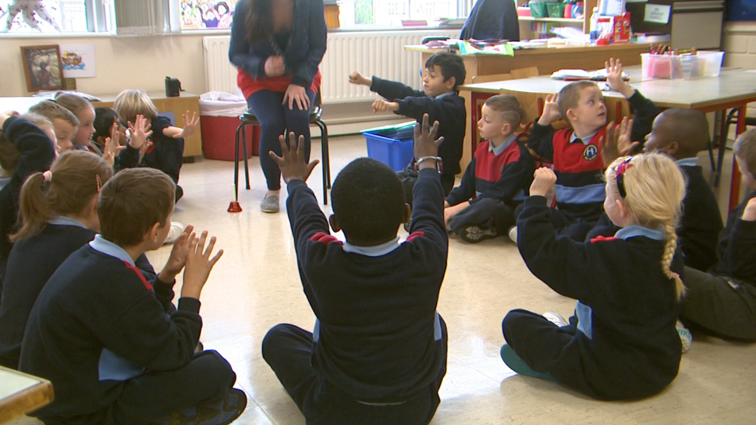
Restorative Practice Strategic Development
  Two strands of work:
    Capacity building in TW;
    All-Ireland strategic forum to promote RP, progress quality assurance and accreditation.

Slide 18

Restorative Practice Strategic Development
  www.restorativepracticesireland.ie
  Publication of quality standards
  Commissioned development of FETAC modules
  Oberstown working to become a restorative community

Slide 19
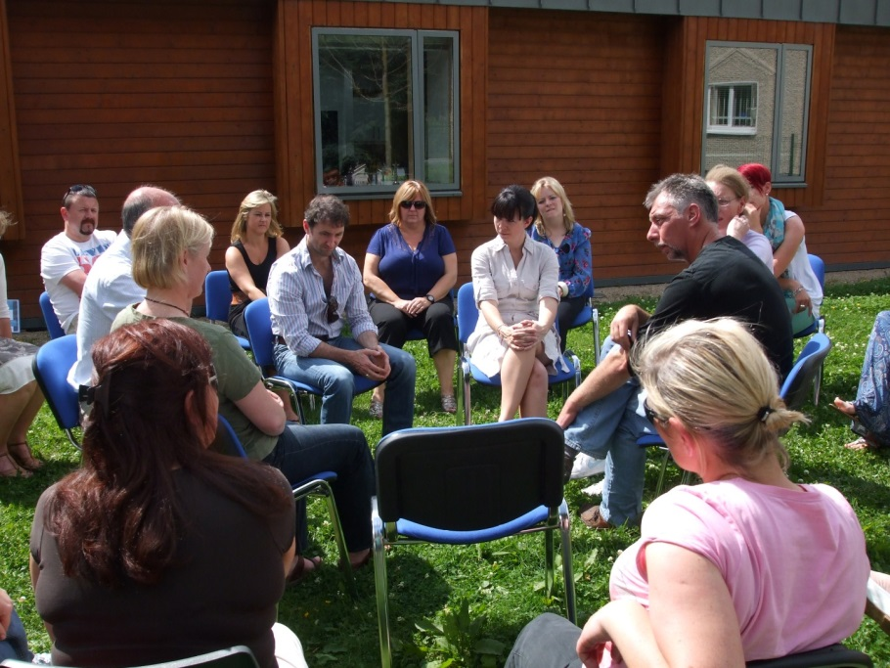
RP Challenges
  Irish Accreditation
  Embedding the approach across disciplines
  Mechanisms to quality assure practice

Slide 20
ATTI
Prompted by a recognition that this is a central phase of development;
Consultation process involved:
  Local agencies and parents;
  Policy/’expert’ groups;
  Literature review.
Logic model agreed, steering committee established and links established with KHF development.

Slide 21
Sharing the Learning
Continued delivery of generic and tailored workshops based on CDI’s ‘Quality Services. Better Outcomes’ workbook;
Plans to develop a further module on an integrated evaluation framework.

Slide 22
Next steps?
Opportunities to support replication of proven programmes;
Role in mentoring new ABC areas and other communities?
Local consultation on next phase;
Review of SLT needs in TW;
Mainstreaming discussions (local and national);
Strategic research proposal submitted.

