Slide 1
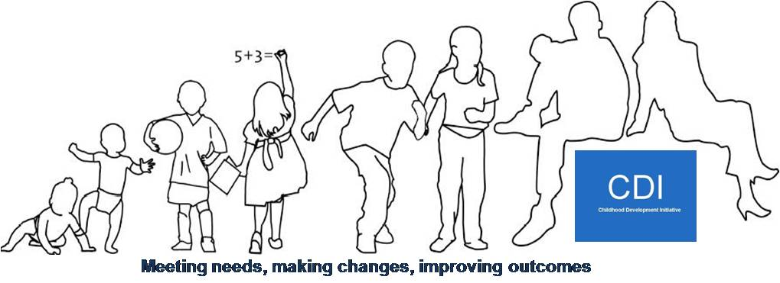
Childhood Development Initiative
“The Next Chapter”
Briefing Session
Friday, 20th September 2013.

Slide 2
Overview:
CDI to Date;
CDI in Numbers;
Underpinning Principles of the ABR’s;
Inclusion in Area-Based Response to Child Poverty Initiative (ABR);
Identification of Core Activities;
Core Activities 2013-2016;
Budget;
Remaining Clarifications.

Slide 3
CDI to Date:
Total spend to date: €15,889,428
Range of services designed, delivered and evaluated;
Seven evaluation reports and eight policy papers published;
Further reports being completed;
Doodle Den Longitudinal Study and SLT follow-up underway.

Slide 4
CDI in Numbers: (To Summer 2013)
195 early years places for pre school children, (26 places subsequently closed);
555 children participated in Doodle Den literacy programme;
420 children participated in Mate Tricks pro-social behaviour programme;
1,100 children have been involved in the healthy schools initiative;
480 children receiving S7L intervention;
Over 250 parents have taken part in formal parent education;
54 full and part time posts created.
Notes:
Figures taken from the service utilisation doc in the CDI in Numbers folder for DD and MT

Slide 5
CDI in Numbers: (cont’d)
CSI worked with over 700 households;
RP training provided to 971 people, 722 of whom are living and/or working in Tallaght West, including 109 young people;
44 lunchtime seminars were held with on average 40 participants at each event;
15 participants supported on the NUI Maynooth Masters in Education Programme.

Slide 6
Underpinning Principles of the ABR:
Continuation and replication of proven or promising models;
No further local evaluation - monitoring to be undertaken centrally by Pobal and CES;
Focus on sustainability of programmes, and their integration into existing structures and mainstream services;
Collaboration with Young Ballymun and PFL.

Slide 7
Inclusion in the Area-Based Response to Child Poverty:
Correspondence from DCYA in December 2012;
Submission and dialogue process between CDI, DCYA and AP March – June 2013, including meetings between Board and Funders and several revisions;
Meeting of Implementation Support Group to consider proposal;
Meetings with local SCP’s;
Discussion at Children’s Services Committee;
Review and approval of proposal by ABR National Project Team.

Slide 8
Identification of Core Activities:
Primarily based on recommendations from independent evaluations;
Negotiations with DCYA and AP;
Requirement to reduce submission costs by 20% (May 2013);
Reduction in CDI staffing.

Slide 9
Core Activities 2013-2016:
Parent support in early years;
Early intervention speech and language service;
Doodle Den;
Sharing the learning;
Restorative Practice Strategic Development.

Slide 10
Unmet Needs of 0-3 Year Olds:
Prompted by a recognition that this is a central phase of development;
Consultation process to involve:
Local agencies and parents – early October 2013;
Policy/’expert’ groups – late October 2013;
Strategy/plan written up – November/December 2013.
Proven model to be identified and implemented.

Slide 11
Doodle Den Plus:
Identified locally in order to sustain benefits for children;
Consultation process to draw on the longitudinal study;
Consultation process to involve:
Local agencies and parents – late October 2013;
Policy/’expert’ groups – early November 2013;
Strategy/plan written up – December/January 2013.

Slide 12
Anticipated Levels of Participation:
Doodle Den 2013/2014:
Children: 240;
Parents: 240;
Staff Supported: 32.
Parent Support in Early Years:
Will work with up to 500 families, with approx. 100 engaging in Parents Plus Courses.
Early Intervention SLT – approx. 150 children.
RP 2013/2014:
Young People: 100;
Parents: 145;
Staff working with children/young people: 525.

Slide 13
Budget:

Slide 14
Remaining Clarifications:
Role of CES and Pobal in monitoring/evaluation processes;
New ABR locations and CDI’s role in mentoring them;
Replication of CDI models beyond existing locations.

